Slide 1
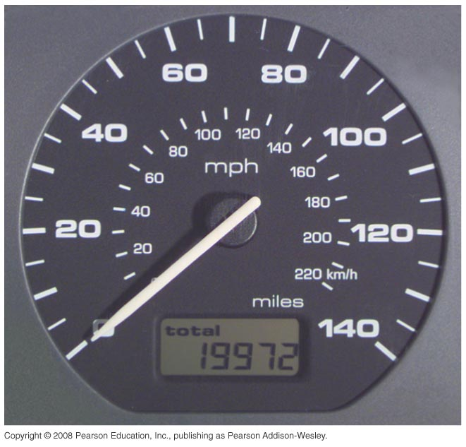
Instantaneous Velocity

Slide 2
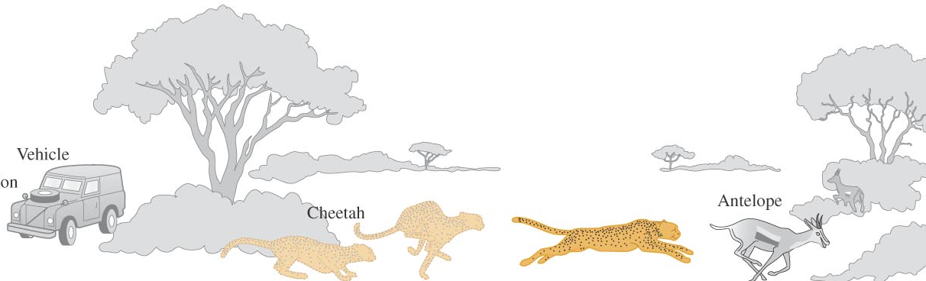
Example: The Cheetah and the Antelope
A cheetah is crouched in ambush 20 m to the east of an observer’s vehicle. At time t = 0 the cheetah charges an antelope in a clearing 50 m east of the observer. Later analysis of a videotape shows that during the first 2.0 s of the attack, the cheetah’s coordinate x varies with time according to the equation

Slide 3
Example: The Cheetah and the Antelope
a) Find the displacement of the cheetah during the interval between t₁ = 1.0 s and t₂ = 2.0 s.
Δx
x (m)
O
x₀ = 20 m
t₀ = 0
x₁ = ?
t₁ = 1.0 s
x₂ = ?
t₂ = 2.0 s
50 m

Slide 4
Example: The Cheetah and the Antelope
At time t₁ = 1.0 s the cheetah’s position x₁ is
At time t₂ = 2.0 s its position x₂ is
The displacement during this interval is

Slide 5
Example: The Cheetah and the Antelope
b) Find the average velocity during the same time interval.

Slide 6
Example: The Cheetah and the Antelope
c) Find the instantaneous velocity at time t₁ = 1.0 s by taking Δt = 0.1 s, then Δt = 0.01 s, then Δt = 0.001 s.

Slide 7
Example: The Cheetah and the Antelope
With Δt = 0.1 s, the time interval is from t₁ = 1.0 s to t₂ = 1.1 s. At time t₂, the position is
The average x-velocity during this interval is

Slide 8
Example: The Cheetah and the Antelope
With Δt = 0.01 s, the time interval is from t₁ = 1.0 s to t₂ = 1.01 s. At time t₂, the position is
The average x-velocity during this interval is

Slide 9
Example: The Cheetah and the Antelope
With Δt = 0.001 s, the time interval is from t₁ = 1.0 s to t₂ = 1.001 s. At time t₂, the position is
The average x-velocity during this interval is

Slide 10
Example: The Cheetah and the Antelope
Instantaneous
velocity at time t₁ = 1.0 s

Slide 11
Example: The Cheetah and the Antelope
d) Derive a general expression for the instantaneous velocity as a function of time, and from it find v_{x} at t = 1.0 s and = 2.0 s.

Slide 12
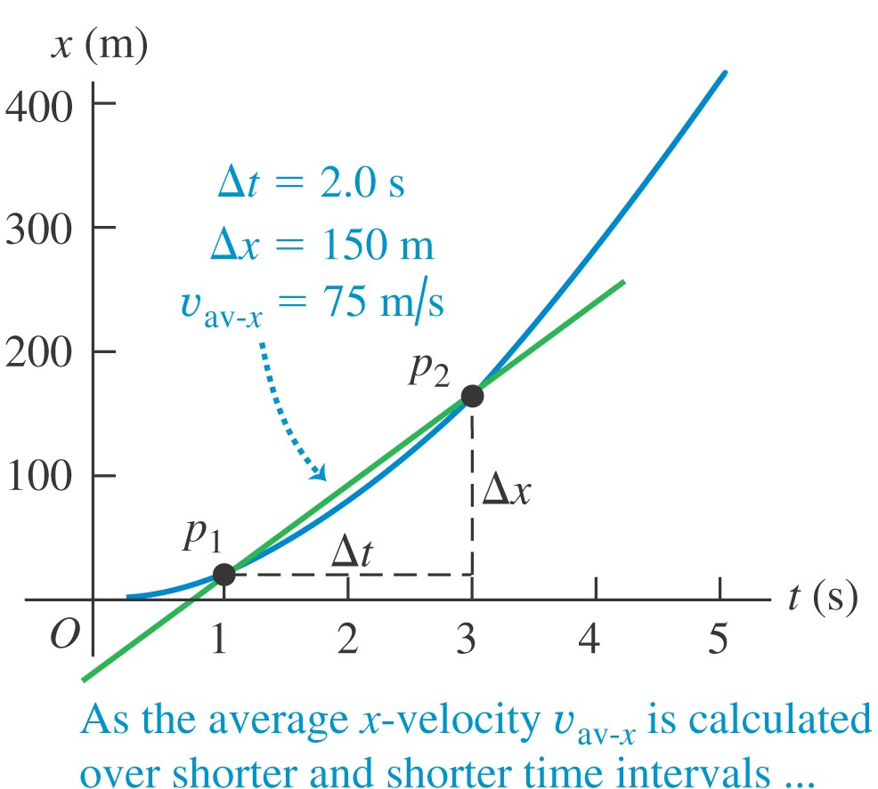
Instantaneous Velocity: Graphical Interpretation

Slide 13
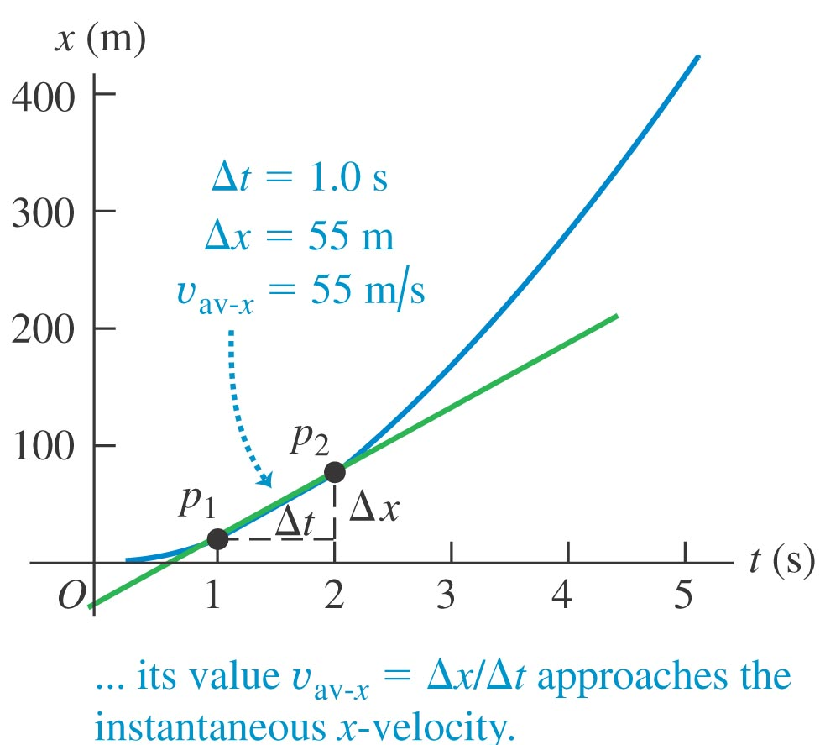
Instantaneous Velocity: Graphical Interpretation

Slide 14
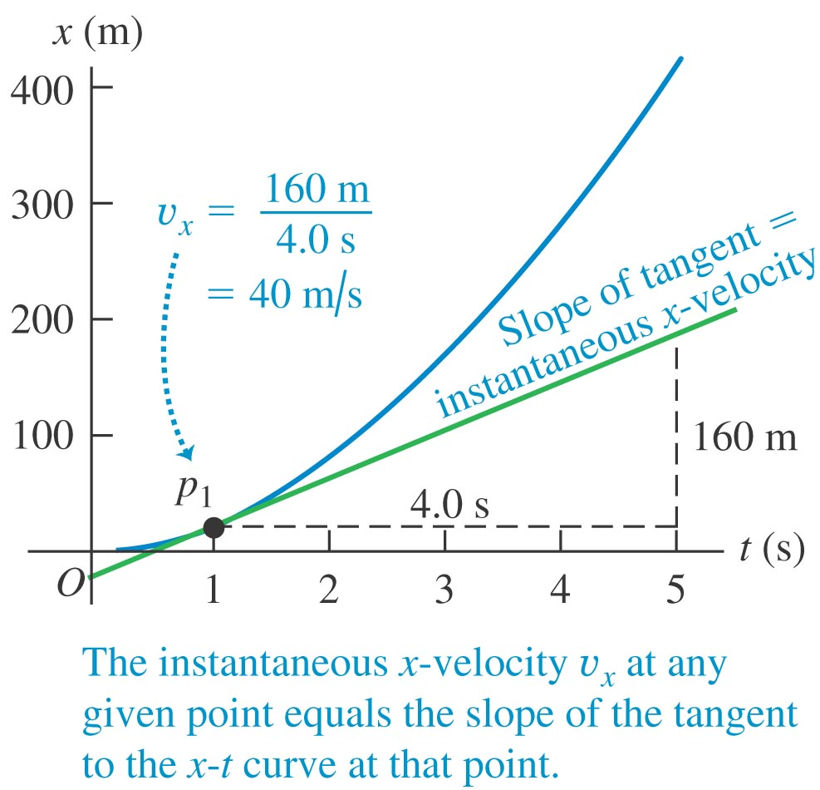
Instantaneous Velocity: Graphical Interpretation

Slide 15
Average Acceleration
Acceleration tells you
how the velocity of an object changes
with time.

Slide 16
Average Acceleration: Test Drive in Space
An astronaut has left an orbiting spacecraft to test a new personal maneuvering unit. As she moves along a straight line, her partner on the spacecraft measures her velocity every 2.0 s, starting at time t = 1.0 s:
t | v_{x}
1.0 s | 0.8 m/s
3.0 s | 1.2 m/s
5.0 s | 1.6 m/s
7.0 s | 1.2 m/s
9.0 s | – 0.4 m/s
11.0 s | –1.0 m/s
13.0 s | –1.6 m/s
15.0 s | –0.8 m/s

Slide 17
Average Acceleration: Test Drive in Space
If the velocity vector and the acceleration vector points toward the same direction, then the object would speed up. Otherwise, it would slow down.

Slide 18
Average Acceleration: Test Drive in Space
If the velocity vector and the acceleration vector points toward the same direction, then the object would speed up. Otherwise, it would slow down.

Slide 19
Instantaneous Acceleration
example:

Slide 20
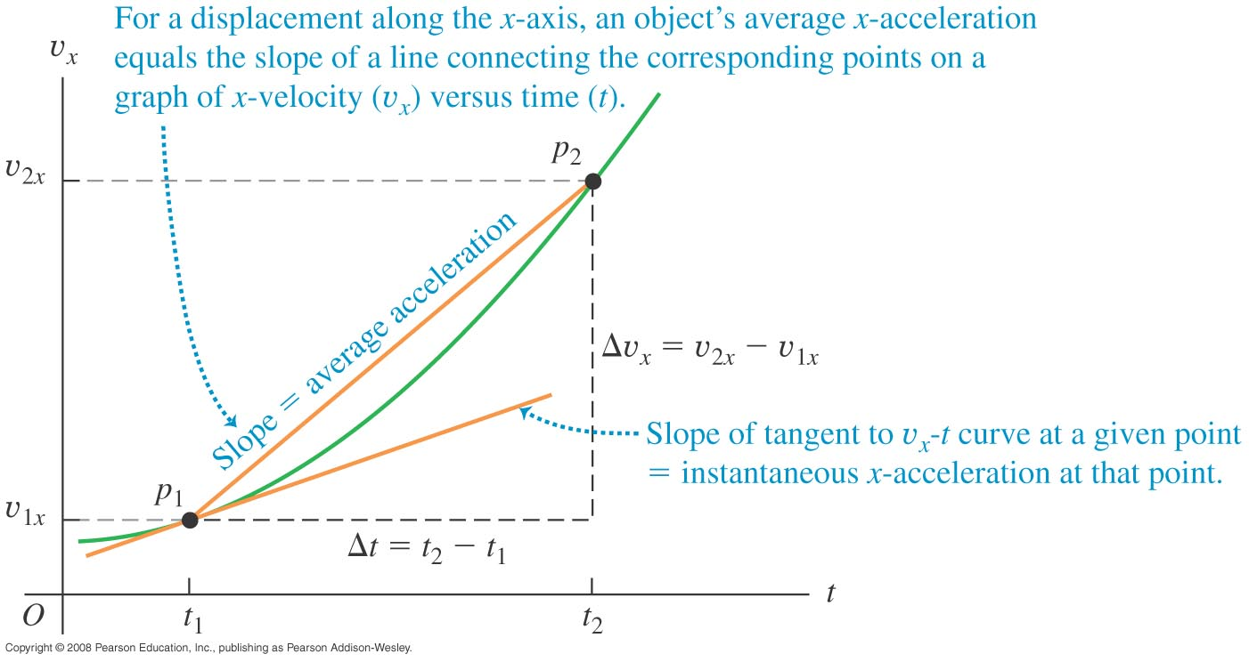
Acceleration (in a v_{x}–t graph)

Slide 21
Velocity – Time Graph
Motion with:
v
increasing acceleration
decreasing acceleration
zero acceleration
0
t
constant acceleration
v-t graph

